Slide 1
Zonghua Gu
Why Learn Assembly Languages
Fall 2025
Acknowledgement: Lecture slides based on Embedded Systems with ARM Cortex-M Microcontrollers in Assembly Language and C, University of Maine https://web.eece.maine.edu/~zhu/book/

Slide 2
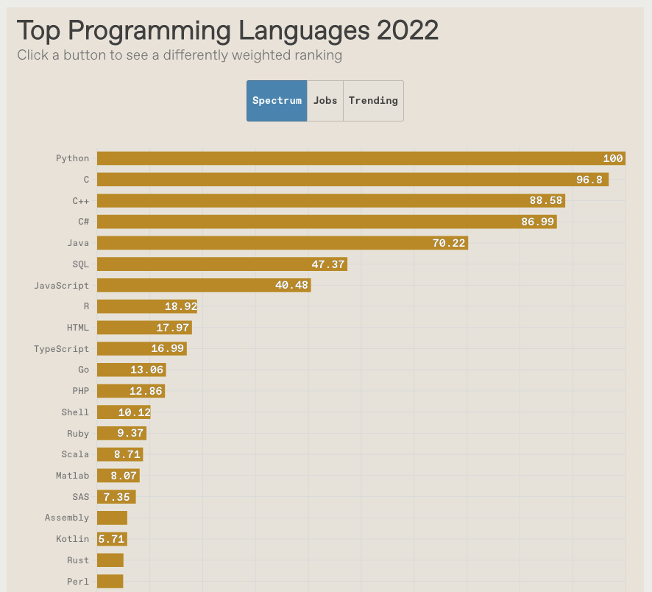
IEEE Spectrum’s Top Programming Languages 2022
https://spectrum.ieee.org/top-programming-languages-2022

Slide 3
Assembly: Not just another language
Assembly vs high level languages (HLLs).
Most embedded systems are programmed in HLLs
Assembly disadvantages
difficult to develop, read, and maintain
bug prone
not portable
However, assembly isn’t “just another language”.
Interface between hardware and software
Implements high-level languages
High-Level Language
Assembly Language
Machine Language
Hardware

Slide 4
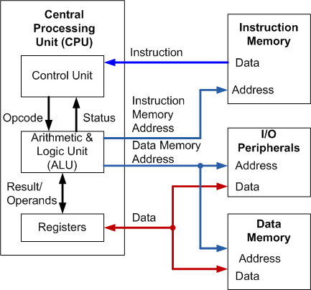
Assembly: Learn how processors work
Learn about the inner workings of a processor
Data representation
Registers
Computer arithmetic
Memory addressing
Instruction set
I/O
Provide background knowledge for later courses
computer architecture,
operating systems,
compiler
Notes:
It is widely accepted that learning assembly programming is often a challenging and frustrated experience.

Slide 5
Assembly: Faster and smaller
Assembly program runs faster than HLLs.
Performance critical codes must be written in assembly.
Use profiling tools to find the performance bottleneck and rewrite that code section in assembly
Latency-sensitive applications, such as aircraft controller
Some C compilers do not use some special Thumb instructions, such as ROR (Rotate Right) and RRX (Rotate Right Extended).
Cost-sensitive applications
Assembly consumes little memory
Embedded devices, where the size of code is limited, wash machine controller, automobile controllers
brilliant.org
Notes:
On many occasions where high speed of running is needed, assembly language is necessary.

Slide 6
Assembly: The only choice sometimes
Hardware/processor specific code,
Special instructions not supported by a compiler
CPSID I ; Disable IRQ by setting PRIMASK
CPSIE I ; Enable IRQ by clearing PRIMASK
MSR/MSR ; Read/write to special registers
WFI ; Enter low-power & wait for interrupt
// Enable Interrupts __attribute__( ( always_inline ) ) static inline void __enable_irq(void) { __asm("cpsie i"); } // Disable Interrupts __attribute__( ( always_inline ) ) static inline void __disable_irq(void) { __asm("cpsid i"); }
cmsis_armcc.h
Notes:
Another example is bootloader. A bootloader is a special and typically small code that is executed when the processor boots. A very useful function is that a customized bootloader can make a microcontroller self-programmable, which allows us to upgrade the on-bard firmware using UART interface or a custom upload procedure.

Slide 7
Assembly: The only choice sometimes
...
Stack_Size EQU 0x400;
AREA STACK,NOINIT,READWRITE,ALIGN=3 Stack_Mem SPACE Stack_Size
__initial_sp
Heap_Size EQU 0x200;
AREA HEAP, NOINIT, READWRITE, ALIGN=3 __heap_base
Heap_Mem SPACE Heap_Size
__heap_limit
__Vectors
DCD __initial_sp ; Top of Stack
DCD Reset_Handler ; Reset Handler
DCD NMI_Handler ; NMI Handler
DCD HardFault_Handler ; Hard Fault Handler
DCD MemManage_Handler ; MPU Fault Handler
DCD BusFault_Handler ; Bus Fault Handler
DCD UsageFault_Handler ; Usage Fault Handler
...
Hardware/processor specific code,
Special instructions not supported by a compiler
CPSID I ; Disable IRQ by setting PRIMASK
CPSIE I ; Enable IRQ by clearing PRIMASK
MSR/MSR ; Read/write to special registers
WFI ; Enter low-power & wait for interrupt
Startup Code
the stack and heap areas
interrupt vector table
default implementation of ISRs
written in assembly, and possible in C with inline assembly
C version is toolchain dependent
startup_stm32l476xx.s

Slide 8
Assembly: The only choice sometimes
Hardware/processor specific code,
Special instructions not supported by a compiler
CPSID I ; Disable IRQ by setting PRIMASK
CPSIE I ; Enable IRQ by clearing PRIMASK
MSR/MRS ; Read/write to special registers
WFI ; Enter low-power & wait for interrupt
Startup code
the stack and heap areas
interrupt vector table
default implementation of ISRs
written in assembly, and possible in C with inline assembly
C version is toolchain dependent
Device driver
access machine-dependent registers and I/O
control exact code behavior in critical sections
static inline u8 __raw_readb(const volatile void __iomem *addr) {
u8 val;
asm volatile("ldrb %0, %1"
: "=r" (val)
: "Qo" (*(volatile u8 __force *)addr));
return val;
}
static inline void __raw_writeb(u8 val, volatile void __iomem *addr) {
asm volatile("strb %1, %0"
: : "Qo" (*(volatile u8 __force *)addr),
"r" (val));
}
Linux 5.6, /arch/arm/include/asm/io.h

Slide 9
Assembly: Help you write better HLLs
Help you understand and write HLLs better
Low-level data representation
C Pointers
Reference & dereference
Passing parameters to functions:
Pass by reference
Pass by value
Variables declared as volatile or static
Inefficiency of recursive function: stack operations
LDR r0, =p
LDR r1, [r0]
ADD r1, r1, #100
STR r1, [r0]
*p += 100
int* pi;
int volatile* pvi;
int* volatile vpi;
Frame for caller
Frame for factorial(5)
Stack grows in recursive phase
Frame for factorial(4)
Stack shrinks in regression phase
Frame for factorial(3)
Frame for factorial(2)
Frame for factorial(1)

Slide 10
Assembly: Help you write better HLLs
uint32_t x = 1;
int32_t y = -1;
if (x > y)
printf("Of course.")
else
printf("Something is wrong!");
Output:
Something is wrong!
r0 = 0x00000001 ; x = 1
r1 = 0xFFFFFFFF ; y = -1
CMP r0, r1
BLS else ; Branch on Unsigned Lower than or Same
compiling main.c...
linking...
Program Size: Code=640 RO-data=424 RW-data=8 ZI-data=5472
FromELF: creating hex file...
".\Objects\project.axf" - 0 Error(s), 0 Warning(s).
Build Time Elapsed: 00:00:01
Notes:
The C integer conversion rules define how C compilers handle conversions. These rules include integer promotions, integer conversion rank, and the usual arithmetic conversions. The intent of the rules is to ensure that the conversions result in the same numerical values and that these values minimize surprises in the rest of the computation.

Slide 11
Assembly: Help you write better HLLs
uint32_t x = 1;
int32_t y = -1;
if ((int32_t) x > y)
printf("Of course.")
else
printf("Something is wrong!");

Slide 12
Assembly: Help you write better HLLs
x = 1;
A
B
x = x + 3;
x = x + 5;
What is the final value of x?

Slide 13
Assembly: Help you write better HLLs
x = 1;
A
B
x = x + 3;
x = x + 5;
x = 4, 6, 9;

Slide 14
Assembly: Help you write better HLLs
x = 1;
A
B
LWR r0, =x
LWR r1, [r0]
ADD r1, r1, #3
STR r1, [r0]
LWR r2, =x
LWR r3, [r2]
ADD r3, r3, #5
STR r3, [r2]
x = 4, 6, 9;

Slide 15
Assembly: Help you write better HLLs
x = 1;
A
B
LWR r0, =x
LWR r1, [r0]
ADD r1, r1, #3
STR r1, [r0]
x = 4
LWR r2, =x
LWR r3, [r2]
ADD r3, r3, #5
STR r3, [r2]
x = 9
x = 9

Slide 16
Assembly: Help you write better HLLs
x = 1;
A
B
LWR r0, =x
LWR r1, [r0]
ADD r1, r1, #3
LWR r2, =x
LWR r3, [r2]
ADD r3, r3, #5
STR r3, [r2]
x = 6
STR r1, [r0]
x = 4
x = 4

Slide 17
Assembly: Help you write better HLLs
x = 1;
A
B
LWR r2, =x
LWR r3, [r2]
ADD r3, r3, #5
LWR r0, =x
LWR r1, [r0]
ADD r1, r1, #3
STR r1, [r0]
x = 4
STR r3, [r2]
x = 6
x = 6

Slide 18
Why should we learn Assembly?
Assembly isn’t “just another language”.
Help you understand how does the processor work
Assembly program runs faster than high-level language.
Performance critical codes may need to be written in assembly.
Use the profiling tools to find the performance bottle and rewrite that code section in assembly
Latency-sensitive applications, such as aircraft controller
Standard C compilers do not use some operations available on ARM processors, such ROR (Rotate Right) and RRX (Rotate Right Extended).
Hardware/processor specific code,
Processor booting code
Device drivers
Compiler, assembler, linker
A test-and-set atomic assembly instruction can be used to implement locks and semaphores.
Cost-sensitive applications
Embedded devices, where the size of code is limited, wash machine controller, automobile controllers
Better understand high-level programming languages

Slide 19
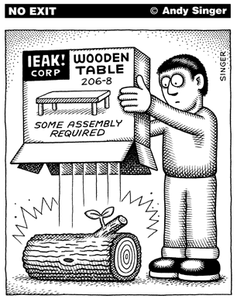
Recap: Why Learn Assembly?
Gain insights about what is under the hood of a processor
Assembly should be used for performance critical sessions
Assembly must be used for processor-dependent instructions that are not supported by compilers
Understanding assembly helps us write better HLLs
www.andysinger.com

